Slide 1
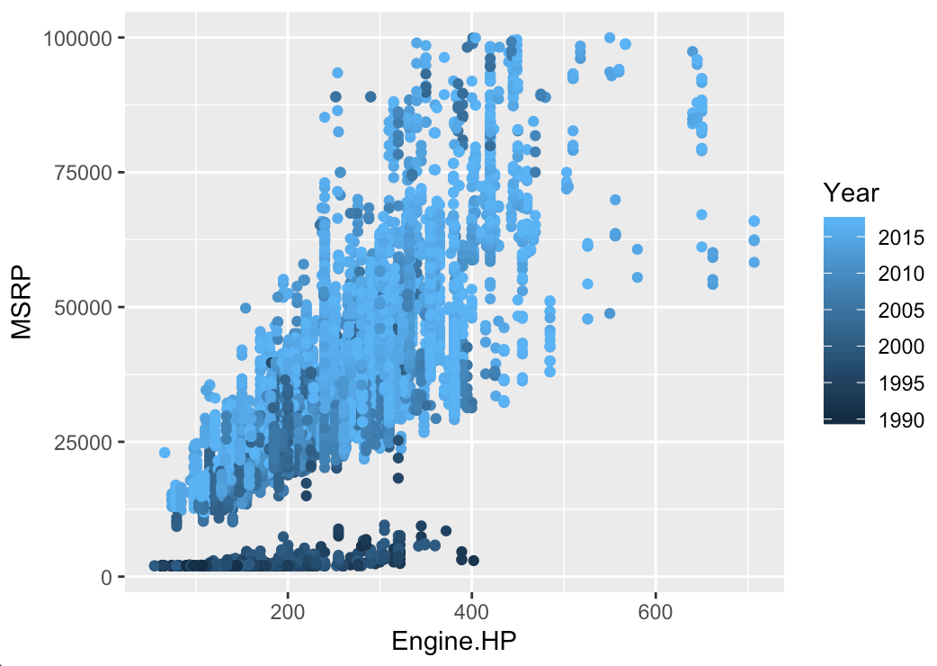
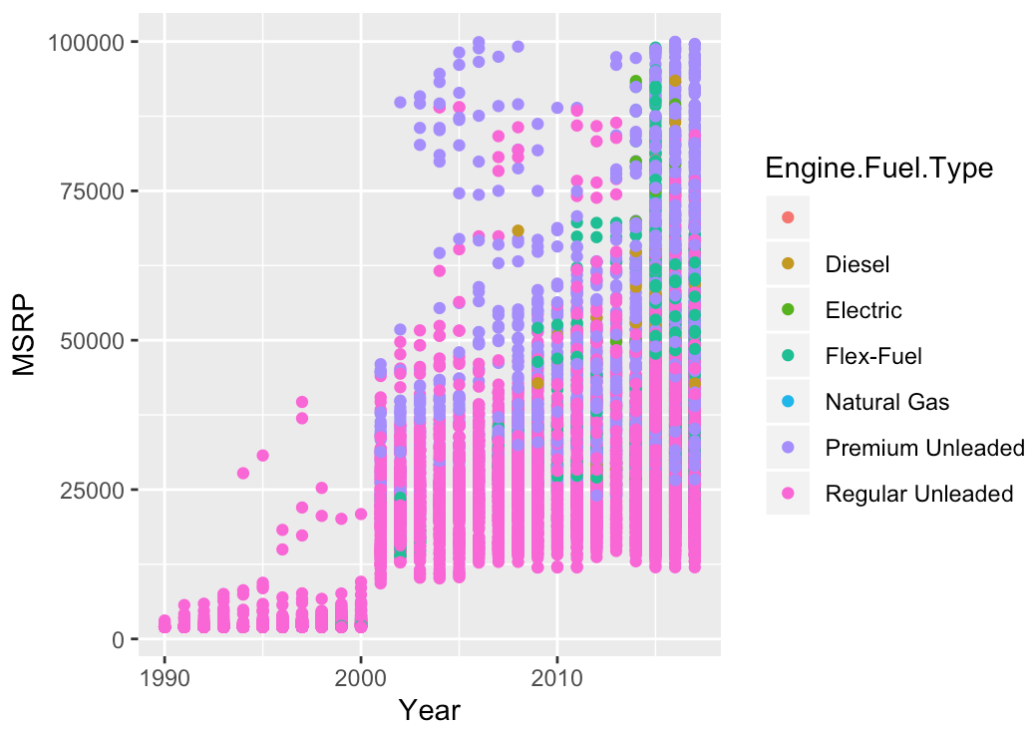
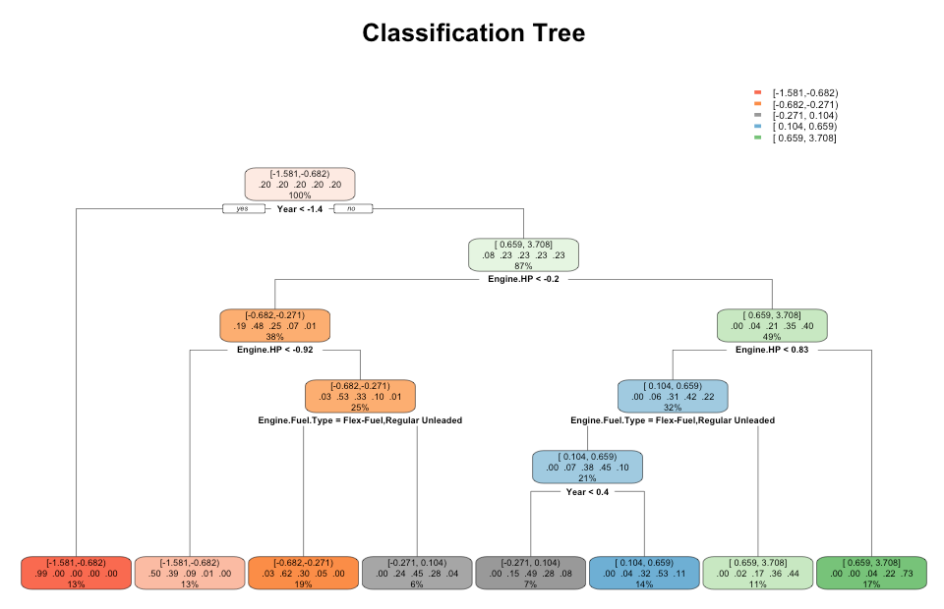
Predicting a Cars Manufacturers Retail Suggested Price
Adam Brudz-Rodríguez and Danielle Senechal
Eastern Connecticut State University
Background and Introduction
Results
Hundreds of thousands, if not millions of cars are sold yearly in America all ranging in different prices. Could factors such as the car’s year, horsepower, MPG or engine fuel type have a role to play in the manufacturer suggested retail price (MSRP)?
or results from the CNN evaluation.
T7
Methodology
In order to come to a conclusion we had to remove duplicated data and filter out cars that retail for more than $100,000 USD. Once that had been done, we created plots and graphics to help us understand the correlation between those factors and a car’s MSRP.
Figure 1. Graph comparing horsepower, MSRP, and year
Figure 2. Graph comparing year, MSRP, and fuel type
Figure 3. Classification Tree which determines MSRP based off year, horsepower, and fuel type
KEY
MSRP:
[-1.581, -0.682] = $1,995-$18,645
[-0.682, -0.271] = $18,645-$26,257
[-0.271, 0.104] = $26,257-33,202
[0.104, 0.659] = $33,202-$43,481
[0.659, 3.708] = $43,481-$99,950
Year:
Year < -1.4 = Years before 2000
Year < 0.4 = Years before 2014
Engine Horsepower:
Engine.HP < -0.2 = 220 horsepower
Engine.HP < -0.92 = 156 horsepower
Engine.HP < 0.83 = 311 horsepower
.
Conclusion
A car’s year, horsepower, MPG, and engine fuel type are good predictors when it comes to predicting a car’s MSRP after taking them into consideration.
Sources:
_{Source of data:}
https://www.kaggle.com/CooperUnion/cardataset

